Slide 1
Necrotizing Fasciitis
L. Katie McKenna

Slide 2
What is it?
Necrotizing: Causing or undergoing cell death
Fasciitis: Inflammation of fascia
(Medical dictionary, 2004)

Slide 3
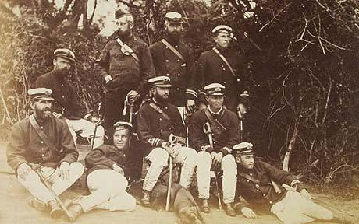
History
British Navel Surgeons
18th- 19th century
Hippocrates
5th Century BC
Dr. Joseph Jones
1871
(Hu, 2002, Kessenich, 2004)

Slide 4
The Bacteria
Type I
Polymicrobial
Type II- Most common
Group A [Beta]-Hemolytic Streptococci
Type III
Marine Vibrio
(Kessenich, 2004)

Slide 5
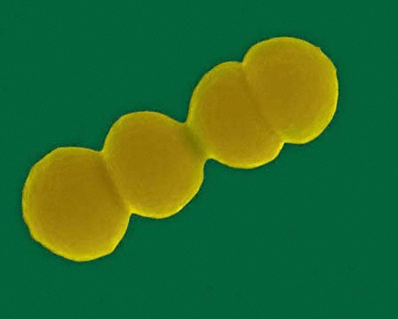
Type II Streptococcus pyogenes
Gram Positive cocci
Group A [Beta]- Hemolytic Streptococci
(Falk, 2007)

Slide 6
Occurrence and Risk
9,000-11,500 cases a year
1,000-1,800 deaths annually
20% of patients with NF die
(Snow, 2008)

Slide 7
Early Signs and Symptoms (Within 24 hours)
Trauma or minor injury occurs
Pain in general area of injury
Pain is disproportionate to injury
Ex. Getting a paper cut and feeling like you‘ve been curling 25lbs. for two hours
Flu like Symptoms
(NNFF, 2005)

Slide 8
Advanced Signs and Symptoms (3 - 4 days)
Swelling
Tenderness
Purple blisters
Skin may appear mottled, purple and flakey
(NNFF, 2005)

Slide 9
Critical signs and symptoms (4-5 days)
Severe drop in blood pressure
Toxic shock
Unconsciousness
(NNFF, 2005)

Slide 10
Diagnosing
Signs and Symptoms
Lab tests
High WBC count
Elevated blood urea nitrogen level
Decreased serum sodium levels
Gram staining
(Bower, 2007)

Slide 11
Treatment
Antibiotics
Debridement
Hyperbaric oxygen therapy
(Snow, 2008)

Slide 12
Surviving Necrotizing Fasciitis

Slide 13
Initial Injury and Symptoms
May 9th
While playing soccer at a church event he was kicked in the left ankle
May 10th
Pain started
2pm he took a trip to the ER
It was diagnosed a minor sports injury
(Salisbury, 2006)

Slide 14
Advanced Symptoms
May 11th
By the afternoon he was nauseous and in excruciating pain
He didn’t have enough strength to walk
His wife took him to the ER
He was admitted for observation and tests were performed
May 12th
His organs began to fail and he was transferred to the ICU at the UC Davis Medical Center in Sacramento CA
(Salisbury, 2006)

Slide 15
Diagnosis and Treatment
A diagnosis of Necrotizing fasciitis was made based on the symptoms
Salisbury was placed on a combination of antibiotics and surgeons began the debridement
(Salisbury, 2006)

Slide 16
Treatment
(Salisbury, 2006)

Slide 17
Grafting

Slide 18
Results
(Salisbury, 2006)

Slide 19
Pre- debridement

Slide 20
During first debridement

Slide 21
Final Skin graft

Slide 22
One Final picture. . .

Slide 23
NCLEX question
Following a small-bowel resection, a male client develops fever and anemia. The surface surrounding the surgical wound is warm to the touch and necrotizing fasciitis is suspected. Another manifestation that would most suggest necrotizing fasciitis is:
A. Erythema. B. Leukocytosis. C. Disproportionate pain. D. Swelling.

Slide 24
NCLEX Question
An ICU patient presented with an infection which lead to gangrene of the subcutaneous tissue and subsequent necrosis of more superficial layers. He was diagnosed with necrotizing fasciitis. What is the infectious cause of Type II necrotizing fasciitis?
A. Polymicrobial
B. Beta-hemolytic Streptococcus
C. Staphylococcal aureus
D. Viral

Slide 25
References
Bower, M. G. (2007). Confronting the "flesh-eating" infection. Nursing, 37(6), 48hn1-
48hn4. Retrieved October 18, 2011 from EBSCOhost http://web.ebscohost.com
Medical dictionary- by the Free Online Medical Dictionary, Thesaurus and
Encyclopedia.." Medical Dictionary. 1 Nov. 2011.
<http://medical-dictionary.thefreedictionary.com/fasciitis>
Falk, Peter.“Flesh Eating Bacteria” bioweb.uwlax.edu 2007.16 Sept. 2010
<http://bioweb.uwlax.edu/bio203/s2007/falk_pete/>
Hu, A. (2002). When Good Bacteria Go Bad- Case of Necrotizing Fasciitis. Journal
of Young Investigators, 5(8). Retrieved October 15, 2011, from
http://www.jyi.org/volumes/volume5/issue8/features/hu.html

Slide 26
References
Kessenich, C. (2004). Necrotizing Fasciitis; Understanding the deadly results of the uncommon
'flesh-eating bacteria'. American Journal of Nursing, 9(104), 51-55. Retrieved October 18,
2011, from the Academic Search Premier Database. http://web.ebscohost.com/ehost/search
Medical dictionary- by the Free Online Medical Dictionary, Thesaurus and
Encyclopedia.." Medical Dictionary. 1 Nov. 2011.
<http://medical-dictionary.thefreedictionary.com/fasciitis>
NCLEX Reviewers NCLEX Practice Test for Skin and Integumentary Diseases Part 2 –
NCLEX Reviewers.NCLEX Reviewers. Retrieved Oct. 18, 2011, from
http://nclexreviewers.com/nclex- review/integumentary-diseases/nclex-practice-test-for-
skin-and-integumentary-diseases-part-2.html

Slide 27
References
Salisbury, Vance. “Over Coming Necrotizing Fasciitis.” flesheatingbacteria.net
2006. 15 Oct. 15 2011<http://www.flesheatingbacteria.net/index.htm>
Snow, M. (2008). Necrotizing Fasciitis: Threatening life and limb. Nursing, 38(11), 23.
Retrieved October 18, 2011, from the Academic Search Premier database.
http://web.ebscohost.com/ehost/search/advanced?sid=4e011f5a-d47a-4e39-b2de-
349da8179e8a%40sessionmgr13&vid=1&hid=13
“ What is NF?” www.nnff.org 17Aug. 2003. National Necrotizing Fasciitis
foundation.15 Oct. 15 2011 <http://www.nnff.org/nnff_what.htm>.
Wound Care & Healing. (n.d.). Medical Student LC. Retrieved Nov. 1, 2011,
from http://www.medstudentlc.com/quiz.php?id=52

